Slide 1
Airbnb: A host to homes or your data?
By Catharine Wu & Yiwen Wang

Slide 2
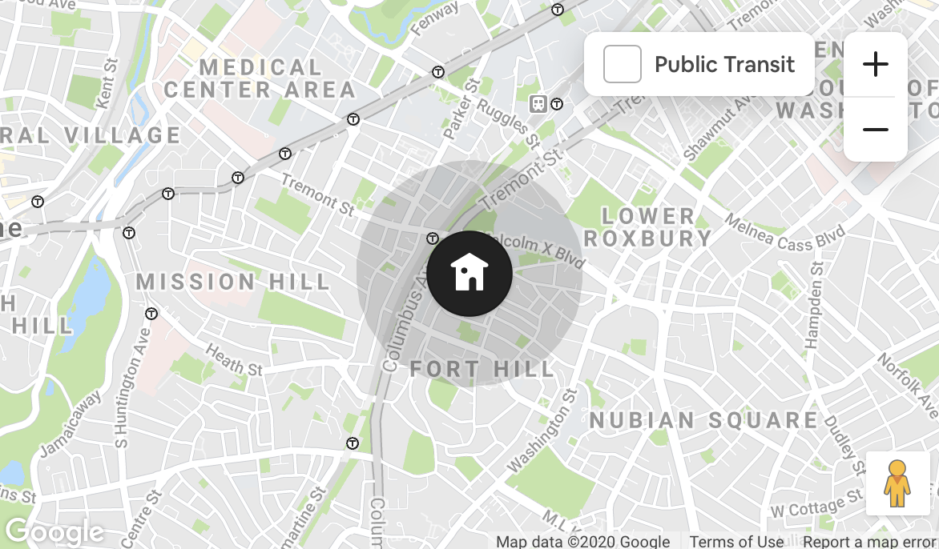
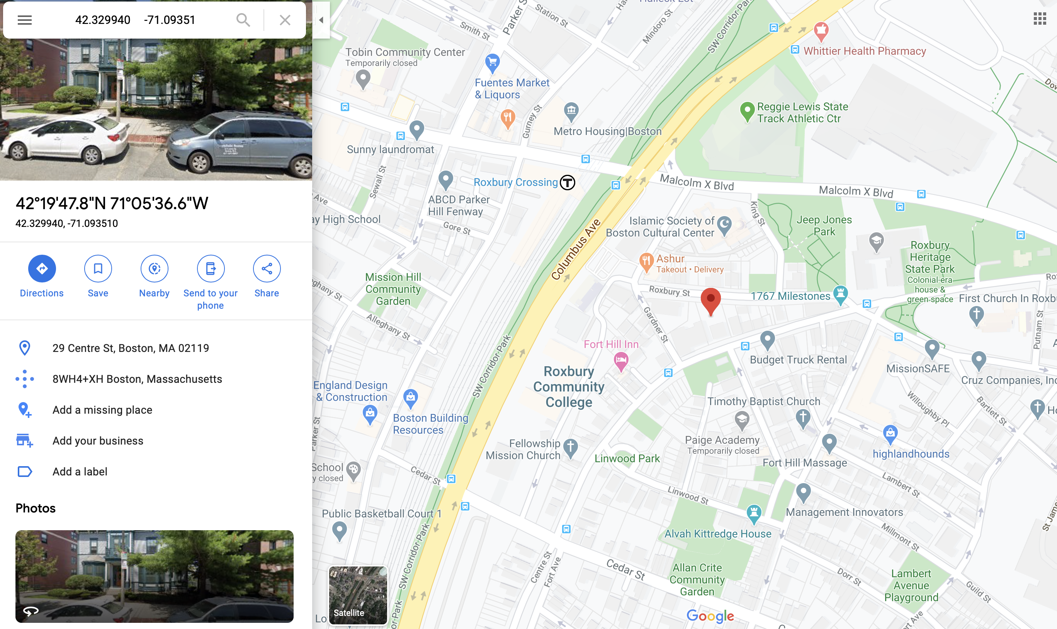
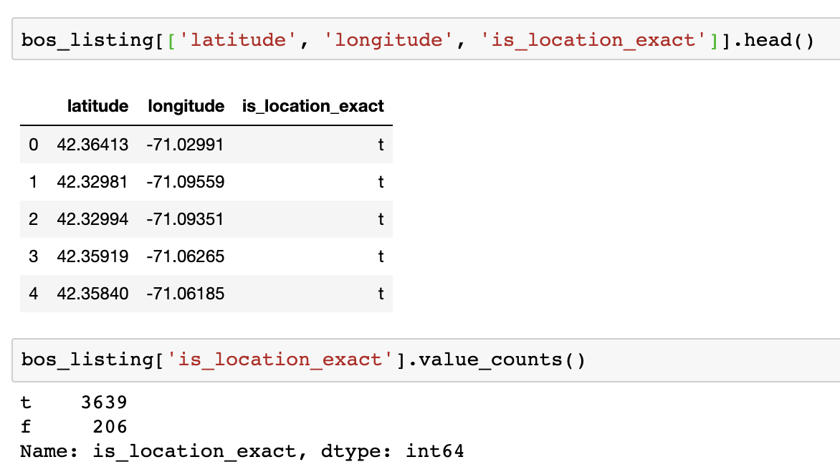
motivation

Slide 3
Outline
Data Cleaning
Basic Pre-processing
Modeling with original data
Anonymization
Modeling with anonymized data
Raw Data

Slide 4
DATA CLEANING
Missing values
Duplicate columns
Columns that are too general

Slide 5
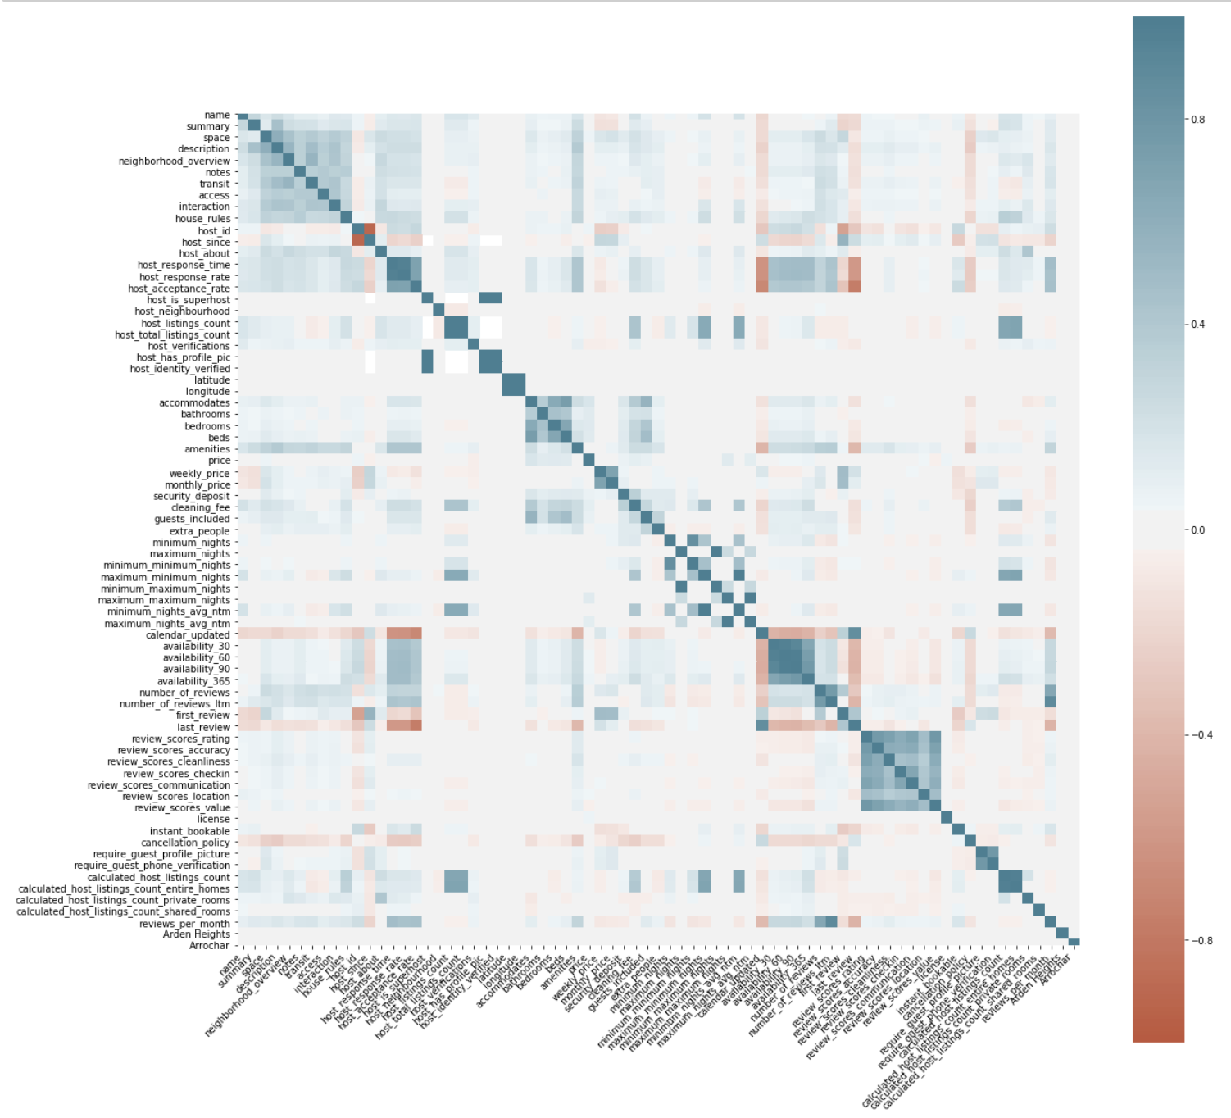
Pre-processing
Data Formatting
Quantitative variables
Categorical variables
Ordinal
Nominal
Text
Correlated columns

Slide 6
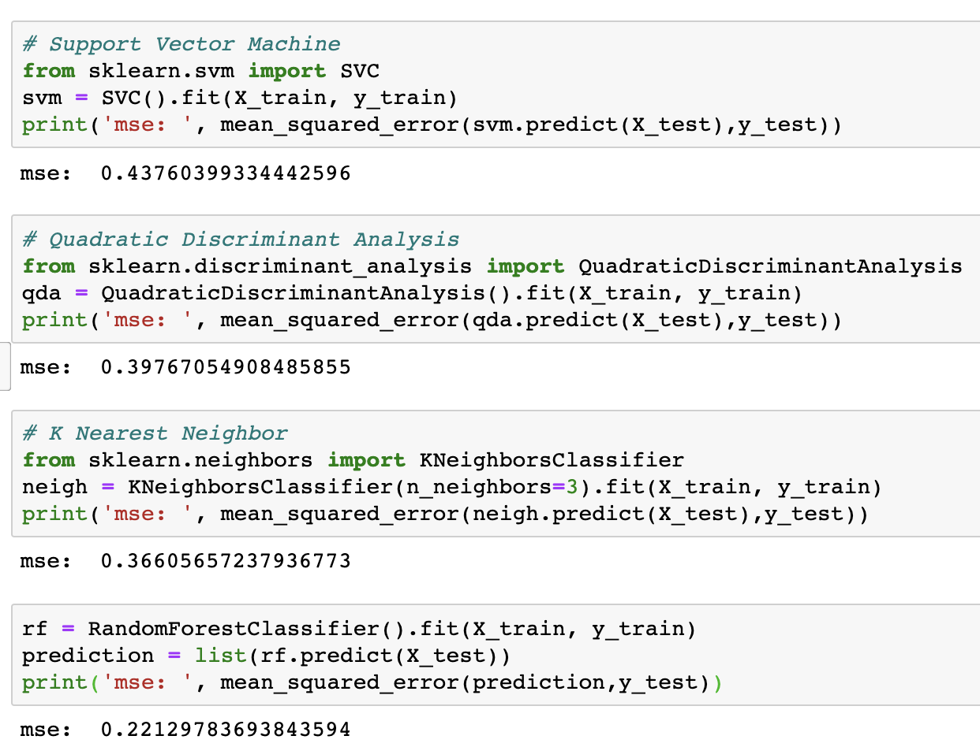
Predicting listing quality If review score = 10 then GOOD Else NOT SO GOOD

Slide 7
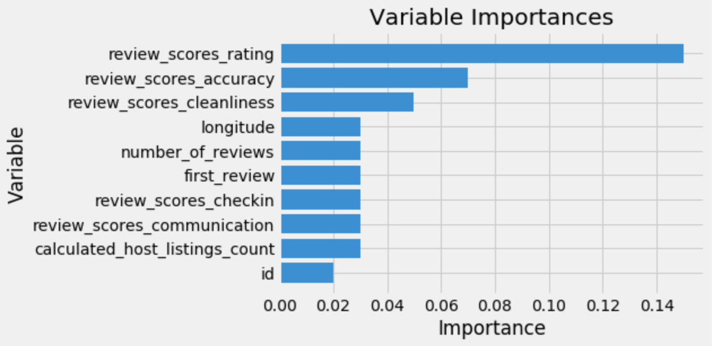
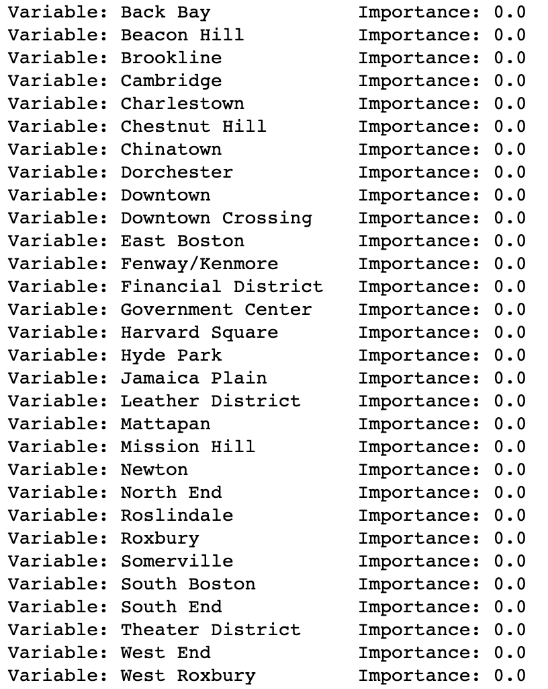
result

Slide 8
Anonymization
3 – anonymous dataset
Unique identifiers: listing_id, listing_name, listing_url, latitude&longitude, host_id

Slide 9
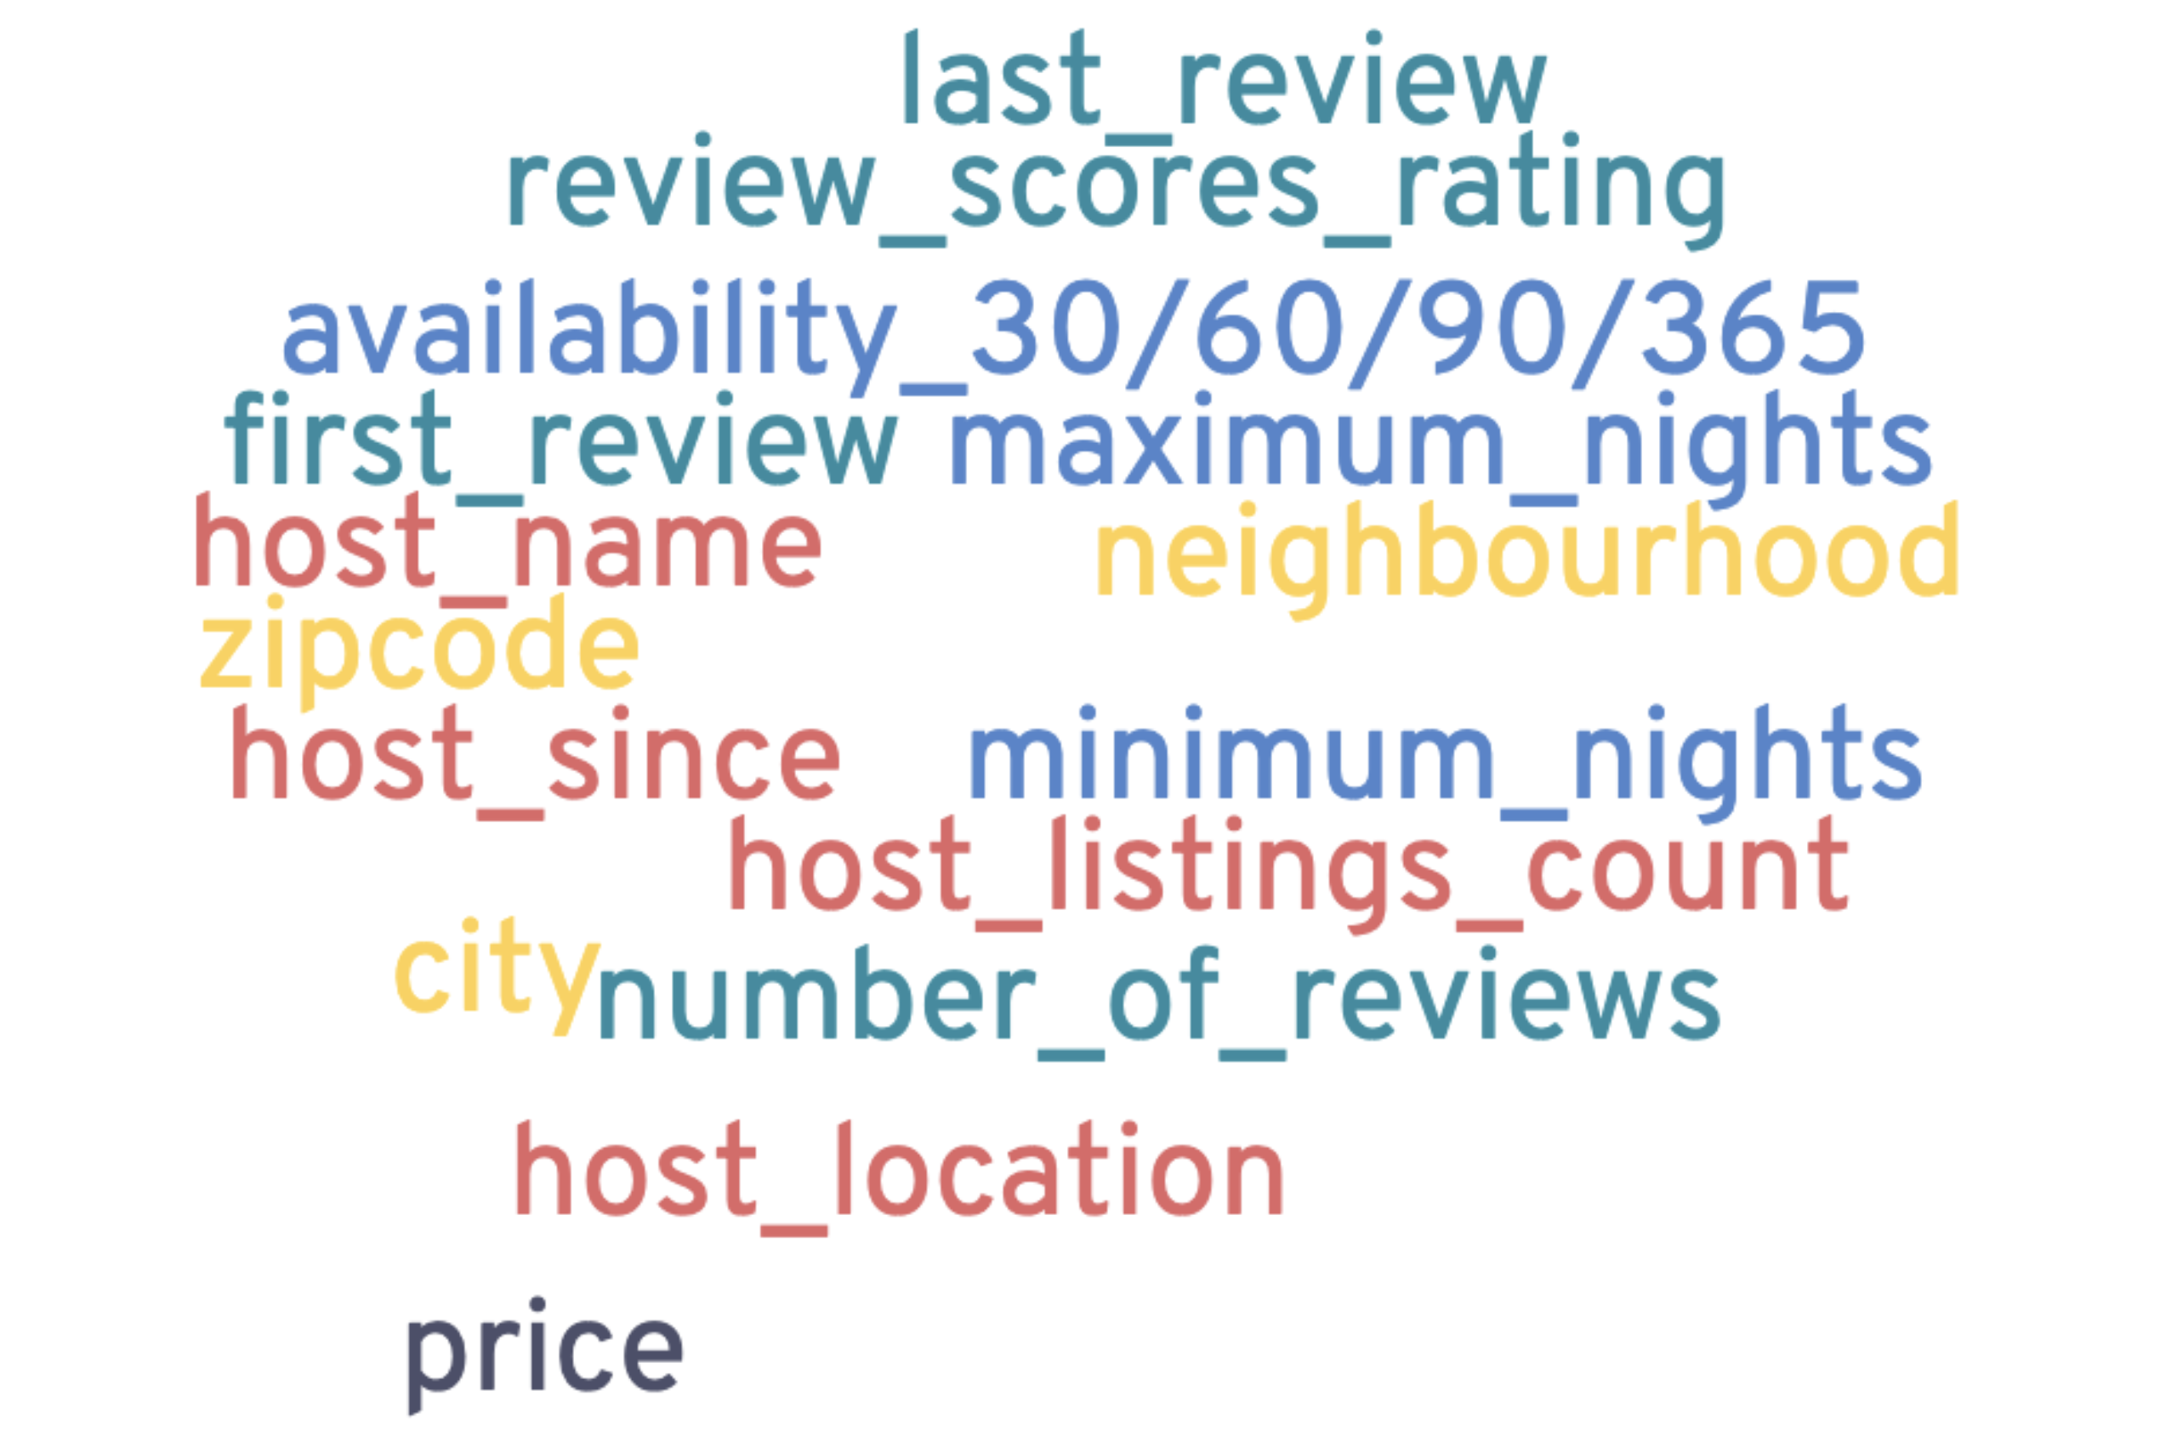
Anonymization
Time data such as host_since:
Keep only the year
Location data such as neighborhood:
Remove all except city
Quantitative data such as number_of_reviews:
Classify into 3 classes: low, average, high

Slide 10
Anonymization
3 – anonymous dataset
Unique identifiers: listing_id, listing_name, listing_url, host_id, latitude&longitude
Generalize and blur quasi-identifiers
Synthetic records
Resample the dataset for columns that are not quasi-identifiers
3845 records -> 9149 records

Slide 11
Model
Predict a listing’s quality/popularity using its review scores
Binary classification:
score of 10: good
Score below 10: not so good
Random Forest model
80% training, 20% testing

Slide 12
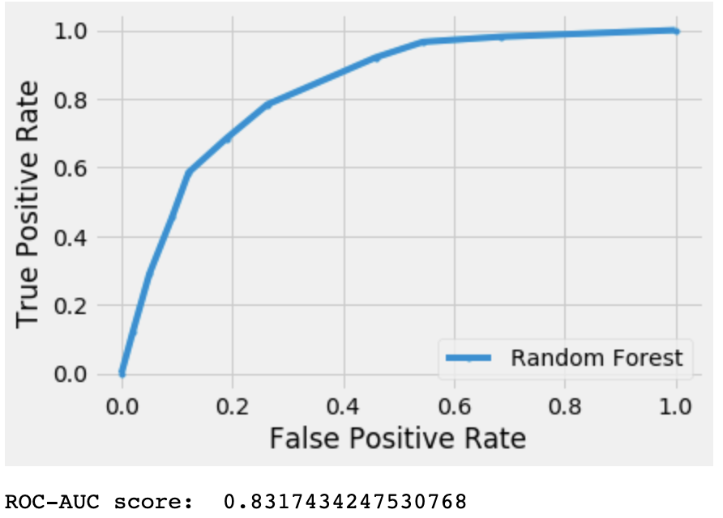
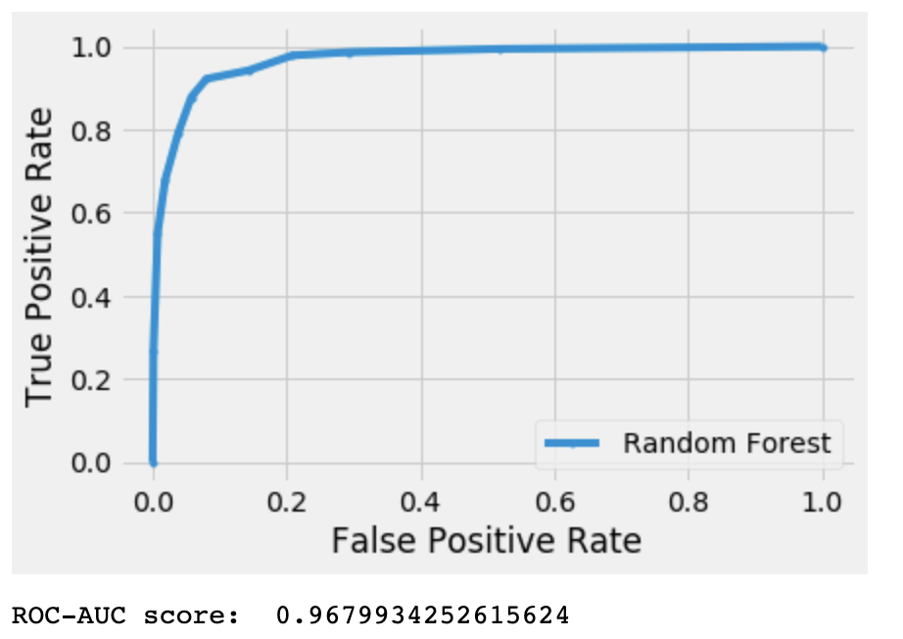
Results
Before Anonymization
After Anonymization

Slide 13
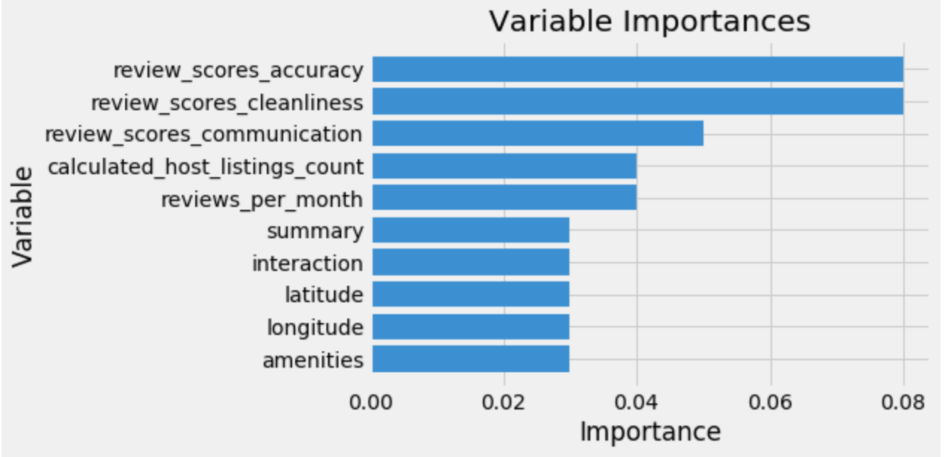
Results
Before Anonymization
After Anonymization

Slide 14
Conclusion
Anonymization helps protect private information such as the location, and host information
It is compatible for the modeling analysis
Removes noise, relieves overfitting and achieves a better performance
Notes:
For data including categorical variables with different number of levels, random forests are biased in favor of those attributes with more levels. Therefore, the variable importance scores from random forest are not reliable for this type of data. Methods such as partial permutations were used to solve the problem

Slide 15
End
Any questions?

